Slide 1
What is final keyword in java ?
final class
final method
Final variables
momedaram

Slide 2
final keyword in java
Final keyword restricts the further modification
A final keyword in java can be used with class, method, variable

Slide 3
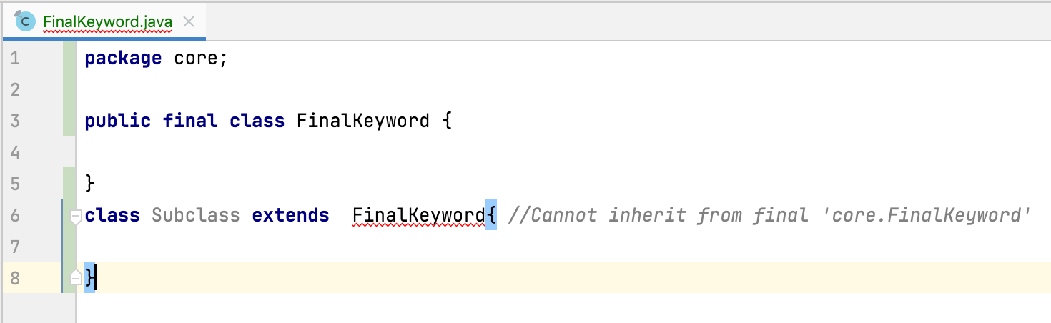
final class :
We can’t create a subclass to the class
Or
We can’t extend a class which is declared as final

Slide 4
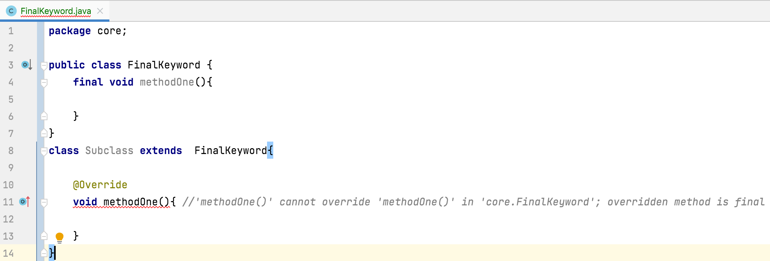
final method :
We can’t override a method
Or
We can’t modify a method which is declared as final

Slide 5
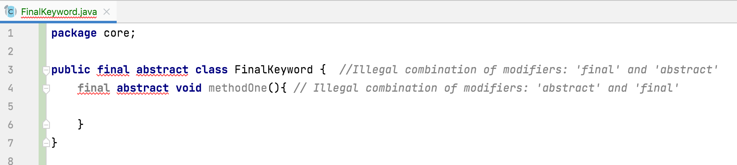
Any class or any method can be eighter abstract or final but not both

Slide 6
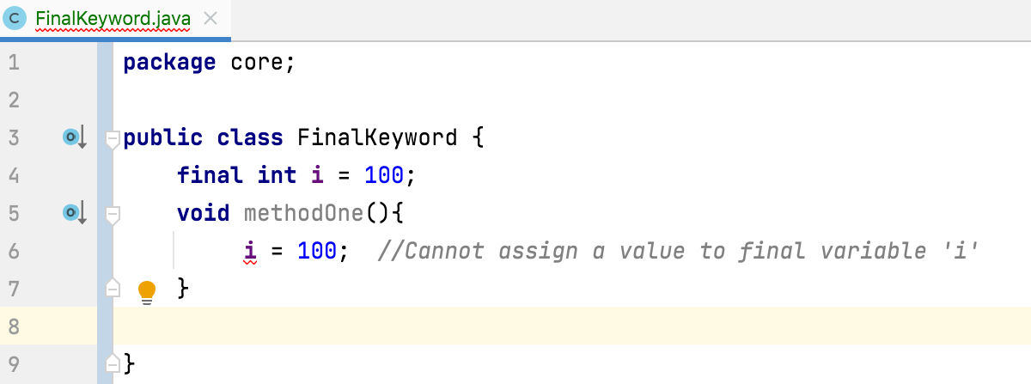
final variable:
The value of a final variable can not be changed in the entire execution once it got initialized.

Slide 7
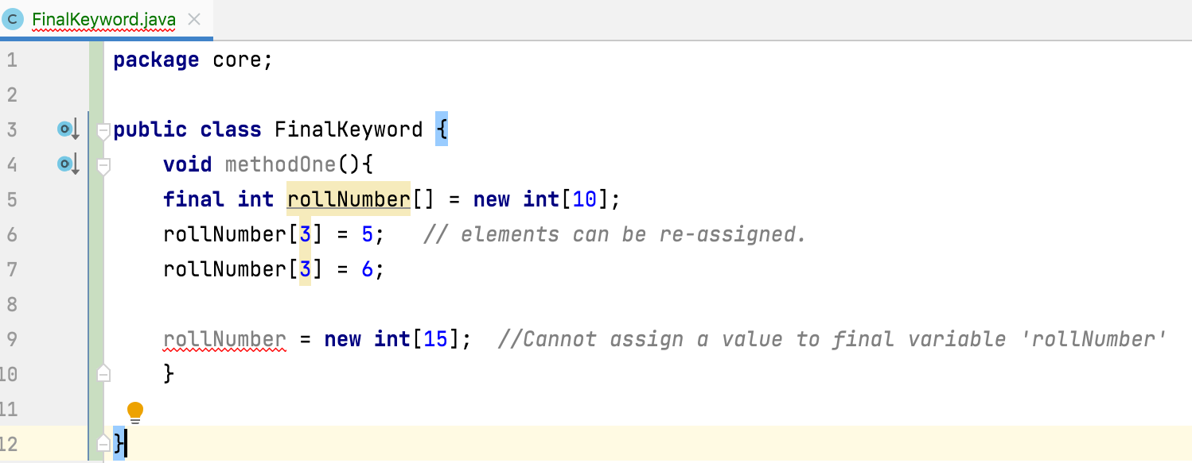
final variable:
If a reference variable is declared as final, you can’t re-assign a new object to it once it is referring to an object

Slide 8
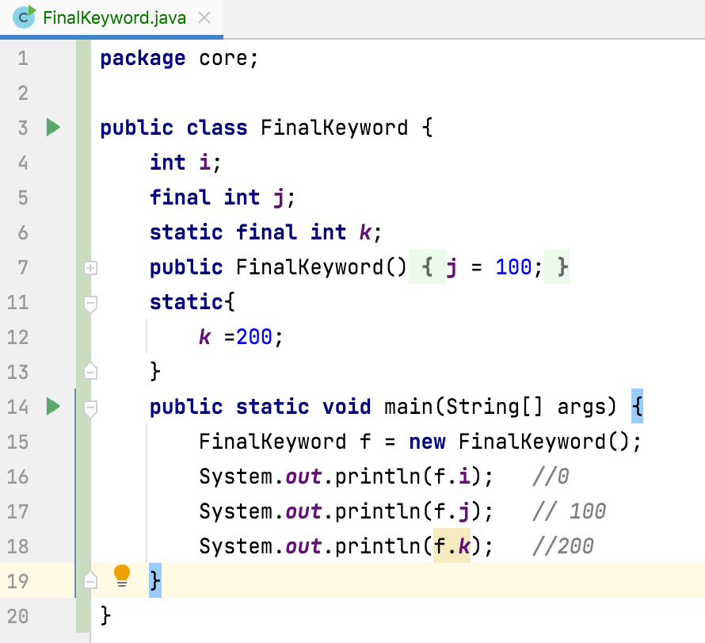
final variable
If the global variables are not initialized explicitly , they get default value at the time of object creation.
final global variables does not get default values so they must be initialized at the time of declaration or in all constructors or in any one of IIBs.
final static global variables must be initialized at the time of declaration or in any one of SIBs (can’t be initialized in constructors).

Slide 9
Thank You !
momedaram

